Slide 1
Threshold of Toxicological Concern
An Answer to a Modern Day Challenge?
Anne Kraus
VP, Food Safety and Quality
E&J Gallo Winery
Alexandria Lau, Ph.D.
Toxicology Program Manager
E&J Gallo Winery

Slide 2
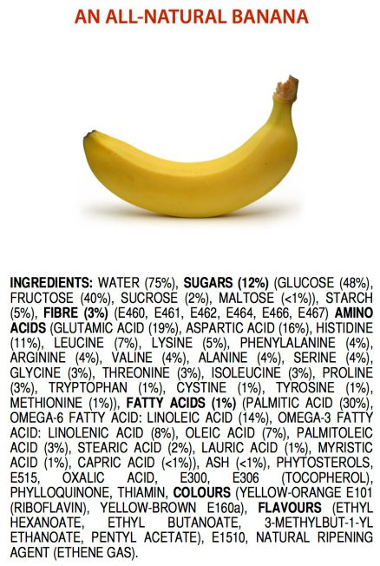
Would you eat this?

Slide 3
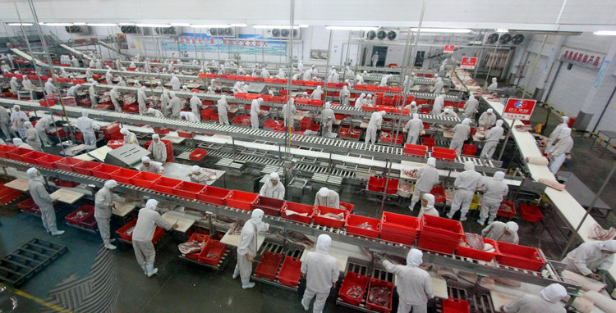
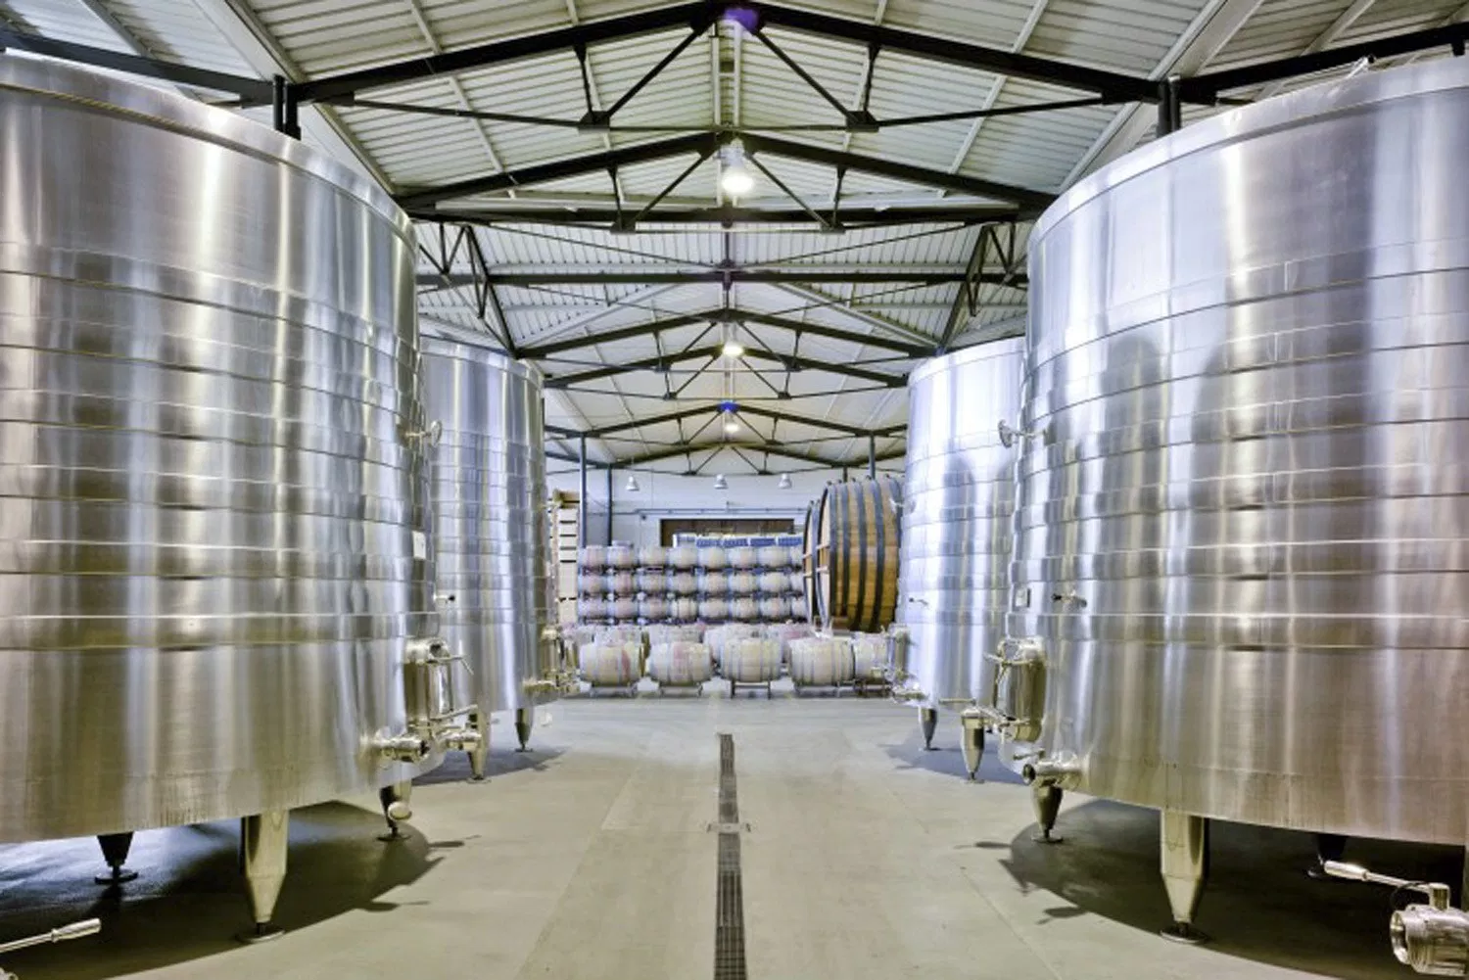
Chemicals in Food:
Past & Present Perspective
Humans have been exposed to chemical compounds that are:
Naturally present in food
Created through processing
For millions of years.
Past
Present

Slide 4
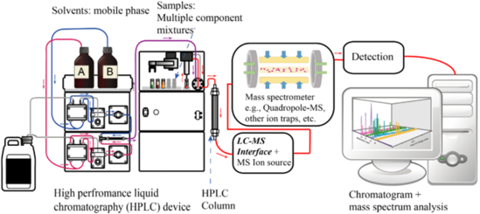
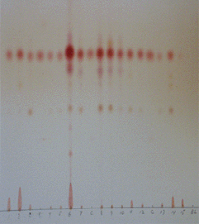
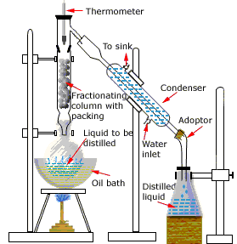
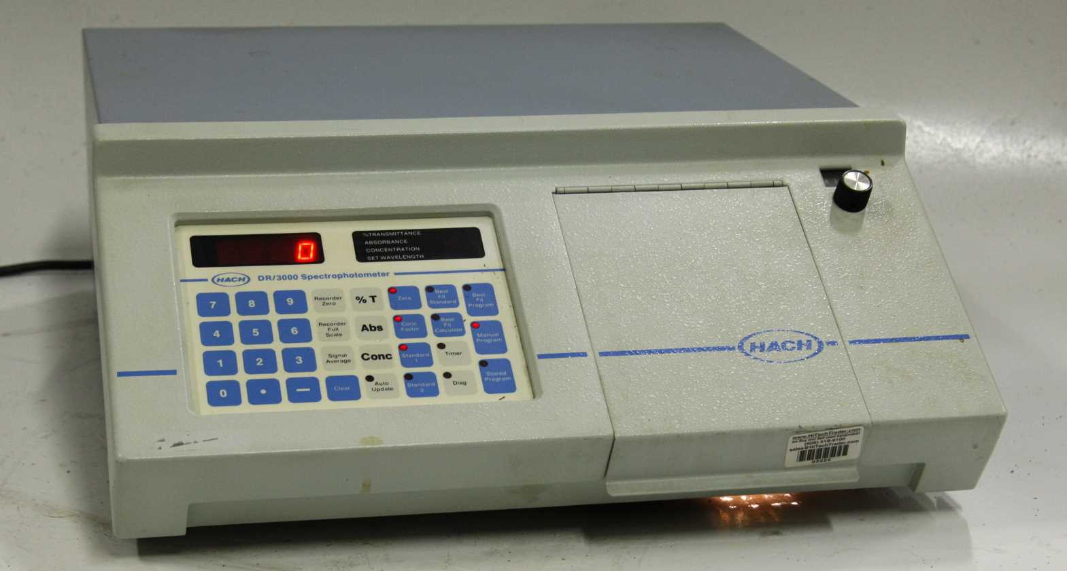
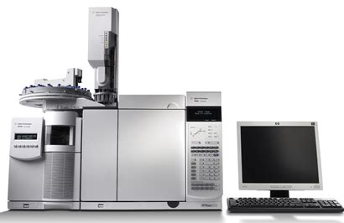
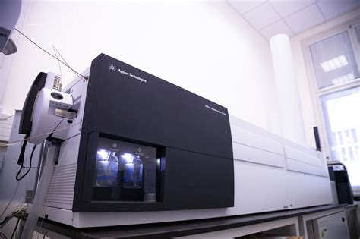
Modern Day Challenge –
Advances in Technology
Many of these compounds are being detected at trace amounts and often there is little or no toxicological data available.
Past
Present
Is public health at risk when chemicals are being identified?

Slide 5
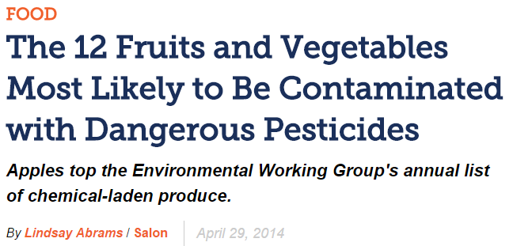
Modern Day Challenge in Food & Beverage – Public perception
Fact: Foods are composed of hundreds of chemicals.
Myth: Detection of chemicals in food = public harm.

Slide 6
Challenges & Solutions
in the wine industry
Wine Institute Technical Advisory Committee created 12 principles that were endorsed by FIVS.
World Wine Trade Group approved the “Tbilisi Statement,” which became 11 principles for wine.
The Missing Principle:
Consider the establishment of analytical “de minimis” values for substances or classes of substances in wine - values below which they will be deemed to all intents and purposes not to be present in the wine.

Slide 7
Can we agree on two things?
1. Regulators, industry, and the public want a safe food supply.
2. Analytical methods are a critical tool to help build effective, risk-based programs to manage chemical risks in food and beverages.

Slide 8
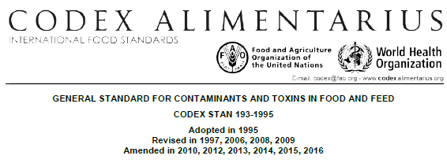
Codex Alimentarius
An organization run by the FAO and the WHO with the objective of supporting food safety and international trade.
The Codex Committee on Contaminants in Foods (CCCF) has developed criteria to guide development of chemical limits:
Limits should be set to protect public health.
Limits should be set based on GMP or GAP to establish a level as low as reasonably achievable.
Limits should not be set lower than it can be analyzed for using a readily available validated method.

Slide 9
Both Analytical Science & Toxicology are needed To determine the risk to Public health
Hazard identification
Hazard assessment
Exposure assessment
Risk assessment
Risk management
Identification of a chemical in a food
Calculate a safe level – threshold
Estimate exposure
Compare threshold to exposure to define risk
Define risk management plan
Analytical Science
Identifies chemical
Generates data to support exposure estimate
Use of validated methods to verify risk management measures
Toxicology
Defines the safe level or threshold
Calculates exposure
Determines if there is a safety concern

Slide 10
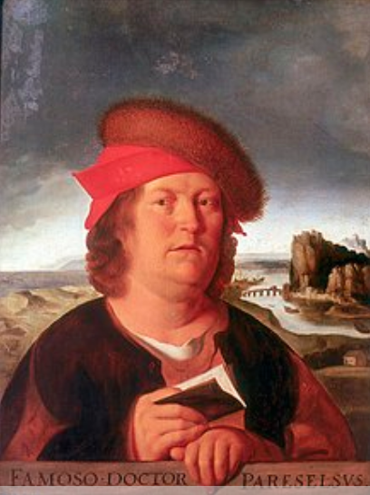
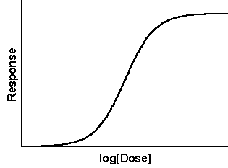
Thresholds: The Foundation of Risk Assessments
Paracelsus: 1493 – 1541 AD
“Solely the dose determines that a thing is not a poison”
Translation:
Everything is toxic at a high enough level
AND
Everything is safe at a low enough level
Contaminants produce no toxicity below the threshold because:
The substance has no physiological effect below that concentration
OR
The body’s homeostatic mechanisms can reverse any effects
Threshold

Slide 11
Case Study: Arsenic in Wine
IMPACTED
83 wines
31 brands
23 companies
Claimed certain wines contain unsafe levels of arsenic based on the limit set by the US Environmental Protection Agency (EPA) for drinking water and Food and Drug Administration (FDA) for bottled water – 10 parts per billion (ppb).
13.5 glasses
3 bottles
The 10 ppb limit is based on typical US consumption of water (2 L/ day).
Moderate US wine consumption (1-2 glasses/day = 0.15-0.3 L/day).
A 10 ppb limit for wine is therefore, overly conservative.
2 L/day
The lawsuit on arsenic has been dismissed in two successive sets of court proceedings.
Thresholds are often times not a “one size fits all” and
consideration of exposure is necessary when utilizing thresholds.

Slide 12
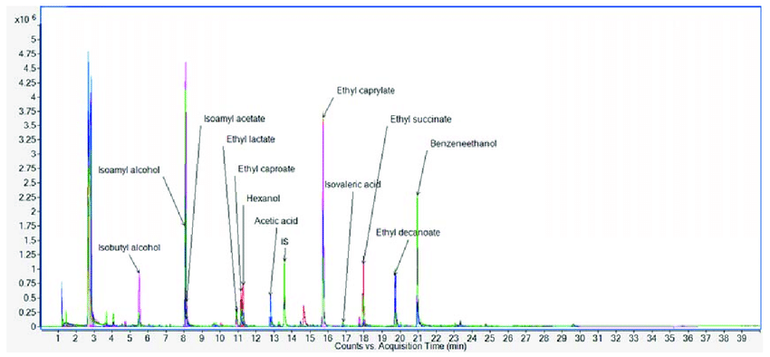
Analytical methods Are advancing faster than ever
 | Past | Present
Method Type | Targeted | Non-targeted
# of Compounds Detected | 1 | 100+
Limit of Quantitation | Parts per million (ppm) | Parts per billion (ppb) or lower
Today’s Challenge
Methods now detect hundreds of contaminants and are not guided by which present the most risk.
Codex and other agencies have recognized the need for guidance on how to prioritize the detection of trace amounts of these contaminants so they can be assessed.

Slide 13
Risk-based method development: A new challenge
The Codex Committee on Contaminants in Foods (CCCF) has begun development of a guidance to create an aligned approach to the prioritization of these chemicals for further risk management.

Slide 14
Codex Alimentarius:
The Proposed Guidelines
Purpose & Scope of the work:
Promote a harmonized approach to addressing public health and trade issues arising from detection of traces of chemicals presenting low exposure and very low public health concern that may inadvertently be present in food.
The proposed work excludes:
Intentional and fraudulent addition of chemicals in food
AND
Any chemicals that are subject to prior regulatory approval requirements

Slide 15
What is Threshold of toxicological concern (TTC)?
Structure Class | Definition of Structure Class | Human exposure threshold (μg/day)
Class I | Structures that suggest a low order of oral toxicity. | 1800
Class II | Less innocuous than those in Class 1 but they do not contain structural features that are suggestive of toxicity like those in Class 3. | 540
Class III | No strong initial impression of safety and may even suggest a significant toxicity. | 90
The Threshold of Toxicological Concern (TTC) is a value where exposure to a chemical below a certain amount would be a negligible concern from a safety perspective.
TTC values are developed based on existing toxicological data of over 600 chemicals with appropriate uncertainty factors incorporated.

Slide 16
How Structure Classes are Determined for TTC

Slide 17
Limitations of TTC
TTC is not intended to be applied to:
Chemicals which are regulated and for which specific requirements exist.
Chemicals that already have specific and robust toxicological data
Certain chemical groups may not be suitable for TTC methodology due to their chemical or toxicological properties. These include:
High potency carcinogens (i.e. aflatoxin-like)
Inorganic chemicals
Metals and organometallics
Proteins
Steroids
Nanomaterials
Radioactive substances
Organo-silicon compounds
Chemicals that are known or predicted to bioaccumulate

Slide 18
When is it appropriate to apply TTC?
TTC is intended to provide health-protective approach in situations where:
Not feasible to acquire chemical-specific data (e.g. impurities and breakdown/reaction products, trace contaminants)
Evaluation of large number of compounds with low exposure (e.g. flavors)
It can be applied under the following conditions:
Hazard data is incomplete for chemical
Exposure can be estimated
Hazard identification
Hazard assessment
Exposure assessment
Risk assessment
Risk management
Identification of a chemical in a food
Calculate a safe level – threshold
Estimate exposure
Compare threshold to exposure to define risk
Define risk management plan

Slide 19
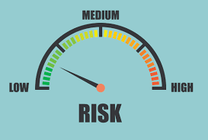
How Can TTC be USED?
Hazard identification
Hazard assessment
Exposure assessment
Risk assessment
Risk management
Identification of a chemical in a food
Calculate a safe level – threshold
Estimate exposure
Compare threshold to exposure to define risk
Define risk management plan
Calculate exposure
Compare exposure to TTC value for appropriate structure class
Determine priority
Low risk – no further tox action; may require analytical testing
High risk – additional data/evaluation, etc.
Determine if chemical is safe
No chemical-specific data available
Determine structure class using decision tree
Test wine
Obtain results identifying hundreds of compounds

Slide 20
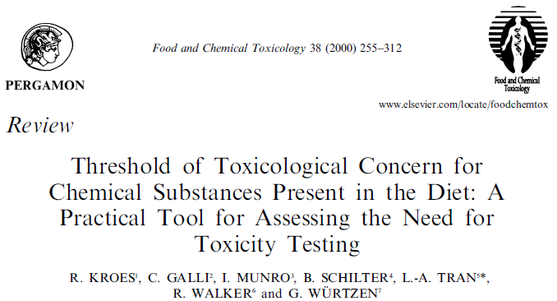
External Use/Acceptance of TTC
Food and flavoring substances (EFSA, JECFA)
Food contact materials (FDA – Threshold of Regulation)
Chemicals (WHO, REACH)

Slide 21
Discussion
Problem:
Analytical chemistry is identifying new substances and detecting them at lower and lower concentrations.
In today’s regulatory framework, detection of any amount of contaminant that does not have a regulatory limit may be non-compliant and could lead to trade barriers.
Questions:
What is the current thinking around thresholds in your country ?
Does the missing Tbilisi principle fill that gap?
Missing principle:
Consider the establishment of analytical “de minimis” values for substances or classes of substances in wine - values below which they will be deemed to all intents and purposes not to be present in the wine.
What methodologies would be an appropriate approach to assess or prioritize detectable, but low level chemicals with low exposure?
Threshold of Toxicological Concern

Slide 22
Thank you for your attention!
Questions?

