Slide 1
Fit For Purpose Analysis
Dr Eric Wilkes

Slide 2
Why do we do chemical analysis?
Chemical testing is means not an end, and is done to address one of the following.
To define a functional or technological requirement of a product
To determine the provenance of a product
To ensure the product is safe for use
To ensure a compliance with regulatory limits
The common requirement of all the above is that the result of measurement actually answers the question posed in an effective manner.
It is for this reason that it is important to ensure that analysis is ”fit for purpose”

Slide 3
Fit for purpose analysis
Answering these questions does not require an absolutely standardised approach to testing any given analyte.
Such an approach can be essentially impossible to implement given the constantly changing technology available and the huge variations in the capabilities of different testing facilities.
Rather, using a “fit for purpose” approach relies on the assessment of method performance to define the suitability of of a given methodology to provide an answer to a given requirement.
Such an approach helps to ensure that not only does the methodology address the requirement it is being used for, but that a range of technologies and facilities can be used to achieve the desired outcome.

Slide 4
Are we testing the correct analyte?
This is not as simple as it sounds.
To actually answer the question being asked, you need to define what is being measured.
A simple example; Measuring sugar
Reducing sugars or glucose/fructose/sucrose?
If the reason for the measurement is determine the perceived sweetness of the product for the consumer or the risk of re-fermentation
Then the relevant measure is glucose/fructose/sucrose
Measuring reducing sugars will provide an artificially high result due to the presence of non-relevant sugars and the interference of non sugar compounds.
This could lead to an inaccurate indication of sweetness or risk of fermentation

Slide 5
Does the test cover the appropriate range?
All analytical measurements have a range of analyte that they accurate for.
It is important that a methodology is chosen that ensures that the value of the analyte of interest falls within this range.
Measuring analyses analytes outside of this range can lead to erroneous results.
e.g. The analyte is present below the limit of detection or it is so high that it gives inaccurate or variable results.
Importantly, it not always necessary to chase zero
If all that is important is the knowledge that an analyse (analyte) is present below a certain value (or not present above a certain level) then it is not always necessary to quantitate it below that value
That is you do not always need the absolute best analytical method, but rather the one that achieves the desired goal

Slide 6
Is the test appropriate for the matrix?
The methodology selected chosen should be chosen such that it is unaffected by other components in the sample.
This is important as it ensures that the result is an accurate reflection of the question being asked.
A simple example
The defined standard Codex methodology for determining sugars is using by determining the ability of a solution to to reduce an aqueous Cu(II) solution in alkaline conditions.
However, the non-sugar components that produce colour in red wine also reduce Cu(II) under these conditions.
This leads to inaccurate and artificially high results
To be used successfully in the red wine matrix, an extra sample preparation step must much be added to the “standard method” to decolour the sample

Slide 7
Does the test provide the appropriate accuracy?
Accuracy describes how close a result is to the actual result (true value).
It is important that the method provides sufficient accuracy to ensure that it can answer the question to be addressed.
If the uncertainty of measurement (UOM) is such that it casts doubt on the answer, then the methodology is inappropriate.
Conversely it is not necessary to over measure.
If the question is simply “what is the weather like?”
A measure such as hot, cold or raining answers the question.
Measurements of barometric pressure, relative humidity, dew point, etc. are essentially wasted and at worse can add confusion.
The same is true in analytical systems in that the methodology should be chosen to provide sufficient accuracy to answer the requirement.

Slide 8
Is the method precise and robust?
Precision is a description of how variable the result from a given methodology is.
All analytical methods provide some variability in the result.
It is important that methodology is chosen so this variability does not impinge on whether it can answer the question that is responsible for the measurement.
Also important is an understanding of the robustness of a methodology i.
This describes how susceptible the method is to small changes in conditions or the influence of other components in a sample matrix.
For example, if a methodology is very susceptible to minor changes in temperature or timing it will probably not be practical in a production or field testing environment.
The same methodology could be perfectly acceptable in a temperature controlled laboratory with highly trained technicians

Slide 9
Is the method practical for needs?
It is nearly always possible to find a better, more accurate methodology for the measurement of a given analyte.
However, the following have to be asked:
Can the method be carried out in a timely manner?
Does the cost of doing the method or the equipment involved prohibit the use of the method?
Can it be done in a reliable manner by the staff available?
Using a methodology which overdelivers for a given requirement can lead to issues with the ability to execute do the method practically and in a timely manner, reducing its efficacy.

Slide 10
Defining what is tested
There are essentially two types of testing.
1. Tests which are defined by the method
e.g. Free SO₂ which describes the equilibrium between bound and unbound SO₂ under certain equilibrium conditions.
2. Tests which are defined by the actual amount of a given chemical entity.
e.g. total SO₂ which as the name implies describes the total amount of SO₂ in solution in all its forms.
For the former, carefully described standard methods defines the required result.
For the latter, the question is reversed and it is a question of if the method can provide an appropriate result.

Slide 11
Analytes defined by methodology
These methods are common for historic methods or for analytes where it is difficult to define a single or group of specific analytes components.
The prime examples in wine analysis include reducing sugars and free sulfur dioxide (SO₂)
Such techniques need to be carefully defined by a standard method.
Alternative methodologies for the same analyte can then be assessed by careful comparison to the reference method. Examples include free SO₂.
Reference is by aeration oxidation without heating
Alternatives include FIA (flow injection analysis) and spectrophotometric techniques
Such analytes are inherently harder to independently validate and compare.
Because they do not relate to a known quantifiable entity they are also harder to assess as “fit for purpose”.

Slide 12
Analytes defined by a distinct chemical entity
Modern techniques and technologies have allowed a many more distinct chemical entities to be directly measured using analytical methodologies.
Such analytes are not defined by the methodology used, so they are much more amenable to being assessed with a range of techniques.
The method performance in terms of precision, accuracy and robustness is used to access if it is fit for purpose.
This allows any variation of method to be used, as long as it meets the performance criteria set out for in the reason for testing.
Also, that it is much easier to define the acceptable criteria for an analyte as it is directly related to the chemical entity at the heart of the reason for the test.

Slide 13
Defining compositional limits
When regulatory, safety or functional limits are defined in terms methodologically defined analytes a number of issues are raised.
It is difficult to link the result to the direct issue leading to the measurement
Changes in technology can lead to significant changes in the result for the same product
The range of methods available to test the analyte is limited
Comparison between different facilities is almost is always more difficult
The majority of these issues are removed when limits are defined in terms of chemically discreet discrete entities and performance criteria.
e.g. sugars as glucose+fructose+sucrose +/- 0.2 g/L
In this example, any methodology can be used for the determination of sugar as long as it can be shown to meet the criteria for measurement.
It also gives more certainty in market access and regulatory environments as there is no question of the variability of the result due to the method used.

Slide 14
The importance of standard methods
Standard methods can be considered very important as;
They provide a guide how to approach an analytical question
For analytically defined parameters, they provide the reference to which other methods are analysed (assessed).
Standards methods don’t;
Determine if a method is fit for purpose (use e.g., Codex reducing sugars example)
Ensure that a laboratory carrying out a the method as described will get an equivalent, or fit for purpose result.

Slide 15
The problem with standard methods
The Chef and the recipe
Most chemists think they can cook, but that does not make them great chefs.
It is quite possible to look up the recipe for a wonderful cake
But having the recipe alone is not always enough to ensure that the cake that is made will be the same as one made by a great chef.
The end result can be influenced by
Variations in ingredients,
Slight differences in timing and technique
Differences in oven temperature and quality
The skill and experience of the chef
Minor details not covered in the recipe
Environmental conditions (humidity, altitude, etc.)
The same is true for analytical testing

Slide 16
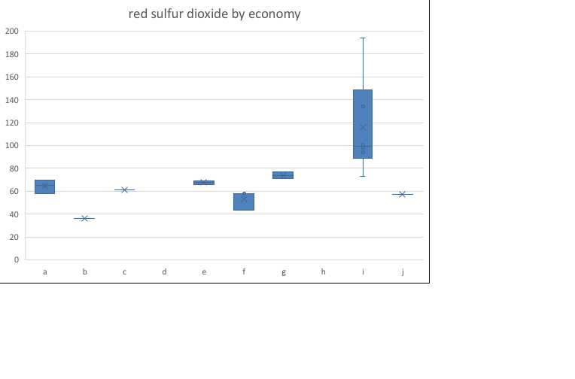
Total SO₂ Case Study
In the 2014 APEC WRF ring test, 5 laboratories submitted results for TSO₂ for a red wine
They all used the same OIV reference method
The results they provided covered a range of over 100 mg/L

Slide 17
Reference methods are only part of the story
Just as in a recipe, reference methods only provide the outline of how to do a method.
They can never define all the details.
Analytical results for a given method can be impacted by a range of factors including
Differences in reagents
Minor differences in technique and timing
Sample handling
Temperature differences
Equipment differences
Differences in the skill and training of the analyst
For this reason a laboratory must ensure that the methodology they choose is not only a standard method…
But that it can show that it is carrying out the analysis in a manner that meets the requirements for doing the test.

Slide 18
The importance of validation
The way that a laboratory shows that a methodology is actually performing in the manner required in its facility is the process of validation.
This is a formal process that measures a range of parameters that define the performance of the methodology and includes measures of;
Accuracy and precision
Linearity
Repeatability
Robustness
Suitability to the matrix
From this process the laboratory can define both;
The scope of testing (i.e. the kinds of sample and ranges of analyte appropriate for the methodology)
The uncertainty of measurement for the method

Slide 19
Validation is non-transferable
It is incredibly important to realise that the validation does not transfer between facilities.
Because no two laboratories are exactly the same, a given “standard method” can lead to different outcomes in each facility.
For this reason, the validation process must be carried out in each facility in which a methodology is used.
This ensures that;
Unforeseen issues that exist for that facility are taken into account and compensated for.
That the uncertainty of measurement for the facility is understood so that meaningful comparison between results from different batches can be made.
The results from different facilities can be compared.

Slide 20
Validation defines the scope of testing
Standard methods do not (necessarily) ensure that the methodology is suitable for the samples to be tested at a given facility.
Appropriate validation ensures that;
The range of analyte falls within the capability of the methodology
That the response for a given analyte is linear over the range of testing
That there are no undue matrix interferences in the samples under study
From this validation a scope of testing which defines the kinds of samples that can be tested by the methodology can be defined.
Samples that fall outside of this scope cannot be tested until they too two have been appropriately validated.

Slide 21
Quality Assurance
Validation does not in any way remove the requirement for continued quality assurance checks.
Small changes over time in;
Environment
Staffing
Reagents
Technique
Sample matrix
…Ccan all lead to significant changes in analytical results.
These kinds of issues are addressed by a defined quality assurance program which ensures that the performance of a methodology is constantly monitored and reviewed.

Slide 22
The take home messages
To be relevant and effective, analytical testing must be:
Fit for purpose in that it actually answers the technological, safety or regulatory questions posed in an effective manner.
Be validated in the actual facility doing the testing to ensure that it is actually providing the necessary information
Be backed up by an effective quality assurance program to ensure continuing conformity of results.
Without all of the above, the value of any testing provided is open to question and likely to be ineffective in meeting the original need that drove the testing.

