Slide 1
2019 International Wine Technical Summit
Certificates of Analysis and “authenticity, safety, and ‘Quality’ ”
June 3-4, 2019
Paul Huckaba
Laboratory Manager, Bronco Wine Company
Winemaker, Redwood VIneyards
Notes:
This is the PowerPoint presentation template for the International Wine Technical Summit.

Slide 2
Certificates of Analysis
Overview:
Background
FIVS Papers on Certificates of Analysis
Safety & Authenticity (2017 & 2018 review)
“Quality”
3. Can basic testing show “Quality”?
4. Are Certificates of analysis necessary?
5. Summary, and Group Discussion Questions
Notes:
This is the PowerPoint presentation template for the International Wine Technical Summit.

Slide 3
Certificates of Analysis
“The Tbilisi Statement”
https://www.trade.gov/td/ocg/wwtg.htm
https://www.wwtg-gmcv.org/
“The ‘Statement on Analytical Methodology and Regulatory Limits’ was adopted to remove unnecessary obstacles to international wine exports. The principles, finalized at the trade group's annual meeting in Tbilisi, Georgia on Aug. 25-26, 2014, were proposed to address a continuing pattern of wine trade barriers. Many countries establish unnecessary rules which delay and add to winery costs, resulting in restricted market access and trade.”
(https://www.wineinstitute.org/resources/pressroom/09022014)
Tbilisi Statement, Principle #01 - AVOID UNNECESSARY ANALYSIS
“GOVERNMENTS SHOULD ESTABLISH REGULATORY LIMITS THAT ARE BASED ON RISK, THEREBY AVOIDING UNNECESSARY ANALYSIS.”
Notes:
This is the PowerPoint presentation template for the International Wine Technical Summit.

Slide 4
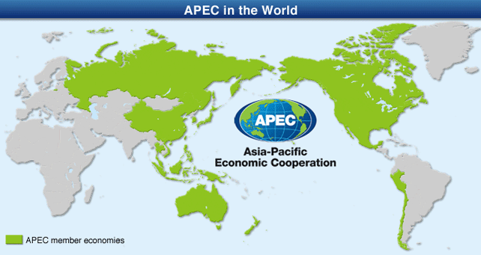
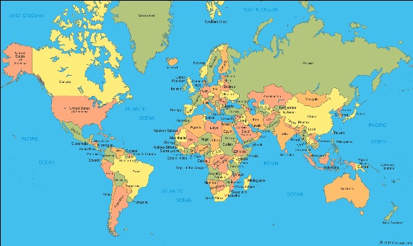
Certificates of Analysis
In the APEC region, “…the costs of unnecessary testing and certification in the region (were) estimated at 1 billion USD per annum.”
$1,000,000,000 USD
$?,???,???,??? USD
Notes:
This is the PowerPoint presentation template for the International Wine Technical Summit.

Slide 5
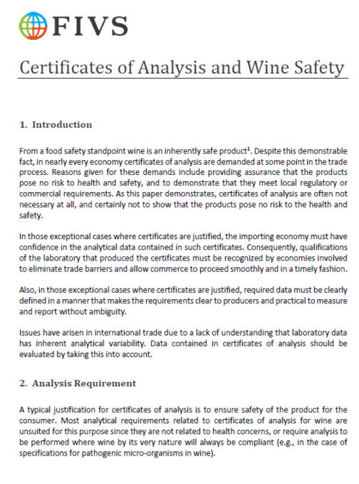
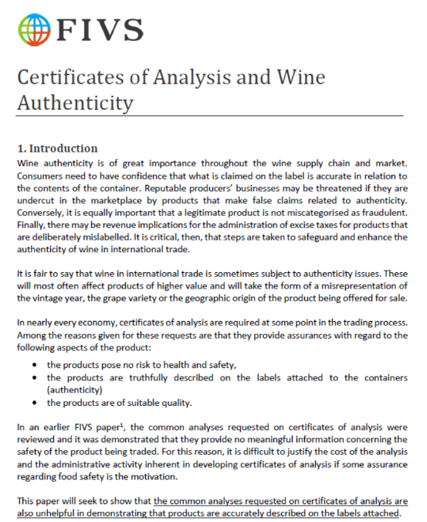
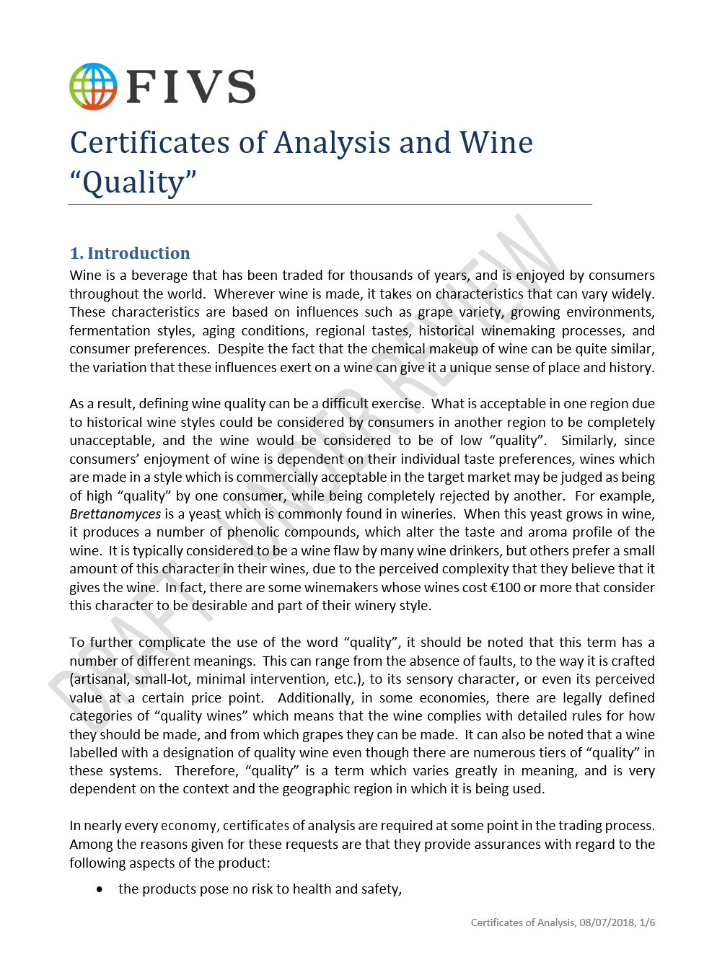
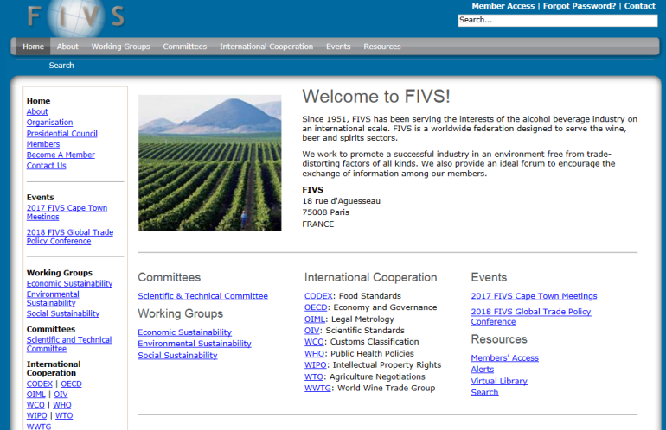
Certificates of Analysis
FIVS papers on Certificates of analysis
Safety
Authenticity
“Quality”
(Draft under review)
www.fivs.org
Notes:
This is the PowerPoint presentation template for the International Wine Technical Summit.

Slide 6
Certificates of Analysis
Is wine an inherently safe product?
A collection of “requested” tests for COAs
Appearance | Hybrids | Stability at -5°C
Bacteria, cultured | Iron | Sucrose
Calories | Lead | Sugar Free Extract
Citric Acid | Limpidity | Titratable Acidity (TA)
Color (sensory evaluation) | Methanol | Total Alcoholic Strength
Copper | Molecular Sulphur Dioxide (SO2) | Total Dry Extract
Density | pH | Total Sugar (Reducing Sugar - Inverted)
Ethanol | Reducing Sugar | Total Sugar
Free Sulphur Dioxide (SO2) | Remaining Extract | Total Sulphur Dioxide (SO2)
Fungus, cultured | Sorbic Acid | Volatile Acidity (VA)
Gas Pressure at 20°C | Specific Gravity | Volume per Bottle
Glucose + Fructose (sugars) | Stability at 55°C | Yeast, cultured
(ETS Labs, Analysis for Exports. St. Helena, California, USA.)
Notes:
This is the PowerPoint presentation template for the International Wine Technical Summit.

Slide 7
Certificates of Analysis
Is wine an inherently safe product?
We can group tests into 6 main categories
Health and Safety – (e.g., Total SO₂)
Wine Quality and Legality – (e.g., Ethanol, Methanol, VA)
Additive Levels – (e.g., Sorbic Acid, Citric Acid)
Microbiological – (e.g., Yeast, Bacteria, Mold, “Fungus”)
Physical Characteristics – (e.g., Stability, Color, Limpidity)
Typical Wine Parameters – (e.g., pH, Sugars)
Notes:
This is the PowerPoint presentation template for the International Wine Technical Summit.

Slide 8
Certificates of Analysis
Is wine an inherently safe product?
“Health and Safety”
Sulfur Dioxide (SO₂)
Methanol
Heavy Metals
Concentrations are too low for concern
Notes:
This is the PowerPoint presentation template for the International Wine Technical Summit.

Slide 9
Certificates of Analysis
Is wine an inherently safe product?
“Wine Quality and Legality”
Ethanol
Gas Pressure
Methanol
Volatile acidity
Quality and legality don’t affect safety
Notes:
This is the PowerPoint presentation template for the International Wine Technical Summit.

Slide 10
Certificates of Analysis
Is wine an inherently safe product?
“Additive Levels”
Mostly Grape-Derived
Difficult to determine added amount
Good Manufacturing Practice (GMP) usage
Minimal usage
No risk, Based on jecfa evaluations
Concentrations are too low for concern
Notes:
This is the PowerPoint presentation template for the International Wine Technical Summit.
.

Slide 11
Certificates of Analysis
Is wine an inherently safe product?
“Microbiological”
Yeast/fungus, Bacteria (Quality only?)
Pathogens (E. Coli, Salmonella)
“Microbiologically, wine is a low food safety risk consumer product”
(https://www.bio-conferences.org/articles/bioconf/pdf/2016/02/bioconf-oiv2016_04003.pdf)
Pathogens don’t survive in wine
Notes:
This is the PowerPoint presentation template for the International Wine Technical Summit.
.

Slide 12
Certificates of Analysis
Is wine an inherently safe product?
“Physical Characteristics”
Color, limpidity (clarity), Stability
Subjective descriptors
Can vary based on tradition, culture, fashion, or style
Characteristics of wine don’t affect safety
Notes:
This is the PowerPoint presentation template for the International Wine Technical Summit.

Slide 13
Certificates of Analysis
Is wine an inherently safe product?
“Typical Wine Parameters”
pH, Acidity, sugars, density, etc.
Grape-Based, so a narrow range of values
Additions – more of the same?
Safe in the grapE? Safe in the wine!
Notes:
This is the PowerPoint presentation template for the International Wine Technical Summit.

Slide 14
Certificates of Analysis
Are certificates of analysis for Safety necessary?
Certificate of analysis tests Are either:
Not related to health and safety
Declared on the bottle
Unlikely to reach harmful levels in wines made using Good Enological Practice
So…are they necessary?
2017 – “Could these tests be used to show authenticity?”
Notes:
This is the PowerPoint presentation template for the International Wine Technical Summit.

Slide 15
Certificates of Analysis
What is authenticity?
“The Product is what it claims to be”
Accurate label claims in relation to content
Vintage
Variety
Geographic Origin
Certificates of Analysis may not be necessary
Notes:
This is the PowerPoint presentation template for the International Wine Technical Summit.

Slide 16
Certificates of Analysis
Appearance | Hybrids | Stability at -5°C
Bacteria, cultured | Iron | Sucrose
Calories | Lead | Sugar Free Extract
Citric Acid | Limpidity | Titratable Acidity (TA)
Color (sensory evaluation) | Methanol | Total Alcoholic Strength
Copper | Molecular Sulphur Dioxide (SO2) | Total Dry Extract
Density | pH | Total Sugar (Reducing Sugar - Inverted)
Ethanol | Reducing Sugar | Total Sugar
Free Sulphur Dioxide (SO2) | Remaining Extract | Total Sulphur Dioxide (SO2)
Fungus, cultured | Sorbic Acid | Volatile Acidity (VA)
Gas Pressure at 20°C | Specific Gravity | Volume per Bottle
Glucose + Fructose (sugars) | Stability at 55°C | Yeast, cultured
Health and Safety – (e.g., Total SO₂)
Wine Quality and Legality – (e.g., Ethanol, Methanol, VA)
Additive Levels – (e.g., Sorbic Acid, Citric Acid)
Microbiological – (e.g., Yeast, Bacteria, Mold, “Fungus”)
Physical Characteristics – (e.g., Stability, Color, Limpidity)
Typical Wine Parameters – (e.g., pH, Sugars)
Six main categories
Notes:
This is the PowerPoint presentation template for the International Wine Technical Summit.

Slide 17
Certificates of Analysis
Can Basic Testing show Authenticity?
Health and Safety – (e.g., Total SO₂)
Wine Quality and Legality – (e.g., Ethanol, Methanol, VA)
Additive Levels – (e.g., Sorbic Acid, Citric Acid)
Microbiological – (e.g., Yeast, Bacteria, Mold, “Fungus”)
Physical Characteristics – (e.g., Stability, Color, Limpidity)
Typical Wine Parameters – (e.g., pH, Sugars)
“Health and Safety”
Sulfur Dioxide (SO₂)
Methanol
Heavy Metals
Not indicators of authenticity
Concentrations found typically overlap, and no substantial variations for vintage, geographic area, or variety
Notes:
This is the PowerPoint presentation template for the International Wine Technical Summit.

Slide 18
Certificates of Analysis
Can Basic Testing show Authenticity?
“Wine Quality and Legality”
Ethanol, Volatile acidity
Methanol
Gas Pressure
Fall in a narrow range of values (Ethanol, VA)
Methanol – If high, then above allowable levels
Gas Pressure – Wine Classification, not Authenticity
Notes:
This is the PowerPoint presentation template for the International Wine Technical Summit.

Slide 19
Certificates of Analysis
Can Basic Testing show Authenticity?
“Additive Levels”
Allowed in wine
Mostly Grape-Derived
Difficult to determine added amount
Presence does not indicate lack of authenticity
Notes:
This is the PowerPoint presentation template for the International Wine Technical Summit.
.

Slide 20
Certificates of Analysis
Can Basic Testing show Authenticity?
“Microbiological”
Yeast/fungus, Bacteria
Global winemaking microbes
Pathogens (E. Coli, Salmonella)
Do not survive in wine
“Microbiologically, wine is a low food safety risk consumer product”
(https://www.bio-conferences.org/articles/bioconf/pdf/2016/02/bioconf-oiv2016_04003.pdf)
Presence would not indicate lack of authenticity
Notes:
This is the PowerPoint presentation template for the International Wine Technical Summit.
.

Slide 21
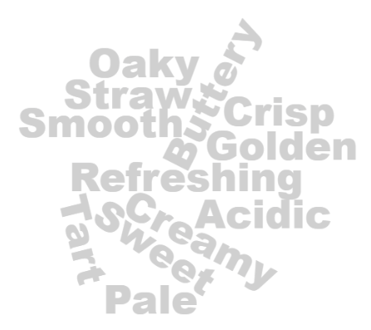
Certificates of Analysis
Can Basic Testing show Authenticity?
“Physical Characteristics”
Color, limpidity (clarity), Stability
Subjective – opportunity for mischaracterization
Can vary based on tradition, culture, fashion, or style
“What Does a California Chardonnay look/taste like?”
Notes:
This is the PowerPoint presentation template for the International Wine Technical Summit.

Slide 22
Certificates of Analysis
Can Basic Testing show Authenticity?
“Typical Wine Parameters”
pH, Acidity, sugars, density, etc.
Mostly Grape-Based, so a narrow range of values which are variable, not fixed
The ranges are well known
Variation within a small range
Well-characterized range, and easy to “replicate”
Notes:
This is the PowerPoint presentation template for the International Wine Technical Summit.

Slide 23
Certificates of Analysis
Overall rationale
Basic tests don’t show authenticity
Sophisticated tests have limits
Wine Variability – Seasonal, winemaking
Blending – Variety, Vintage, Region
Cost, Time, scarcity – Not practical for testing for international trade
Certificates of analysis Can't indicate authenticity
So, are they necessary?
2018 – “Could these tests be used to show Quality?”
Notes:
This is the PowerPoint presentation template for the International Wine Technical Summit.

Slide 24
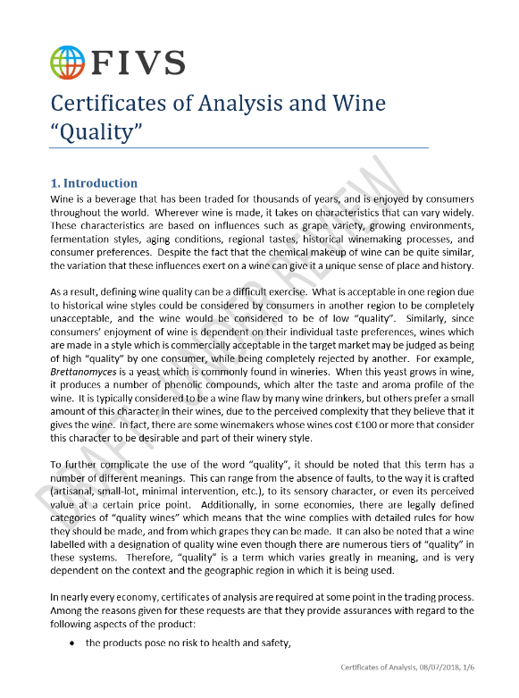
Certificates of Analysis
CAN BASIC TESTING SHOW “QUALITY”?
(Note: FIVS paper is in review, and moving towards consensus agreement)
WHAT IS “QUALITY”?
A very difficult term to define, and even more difficult to quantify
Individual Taste Preference
Historical Wine Style
Price Point
Is it…
Absence of Faults?
“Locally Made”?
Small-Lot or Artisanal?
Part of a legal definition?
?
Notes:
This is the PowerPoint presentation template for the International Wine Technical Summit.

Slide 25
Certificates of Analysis
CAN BASIC TESTING SHOW “QUALITY”?
Health and Safety – (e.g., Total SO₂)
Wine Quality and Legality – (e.g., Ethanol, Methanol, VA)
Additive Levels – (e.g., Sorbic Acid, Citric Acid)
Microbiological – (e.g., Yeast, Bacteria, Mold, “Fungus”)
Physical Characteristics – (e.g., Stability, Color, Limpidity)
Typical Wine Parameters – (e.g., pH, Sugars)
Health and Safety
Sulfur Dioxide (SO2)
Methanol
Heavy Metals
Concentrations found typically overlap, and are in a fairly narrow range
Higher levels may be usual for the wine type
Notes:
This is the PowerPoint presentation template for the International Wine Technical Summit.

Slide 26
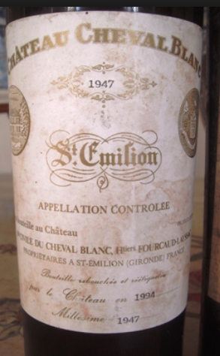
Certificates of Analysis
CAN BASIC TESTING SHOW “QUALITY”?
Wine Quality and Legality
Ethanol
Volatile acidity (VA)
Methanol
Gas Pressure
Fall in a narrow range of values (Ethanol, Methanol)
VA – Higher levels can be typical, and add complexity
Gas Pressure – CO2 Level, not “Quality”
*
Authentic?
Notes:
This is the PowerPoint presentation template for the International Wine Technical Summit.

Slide 27
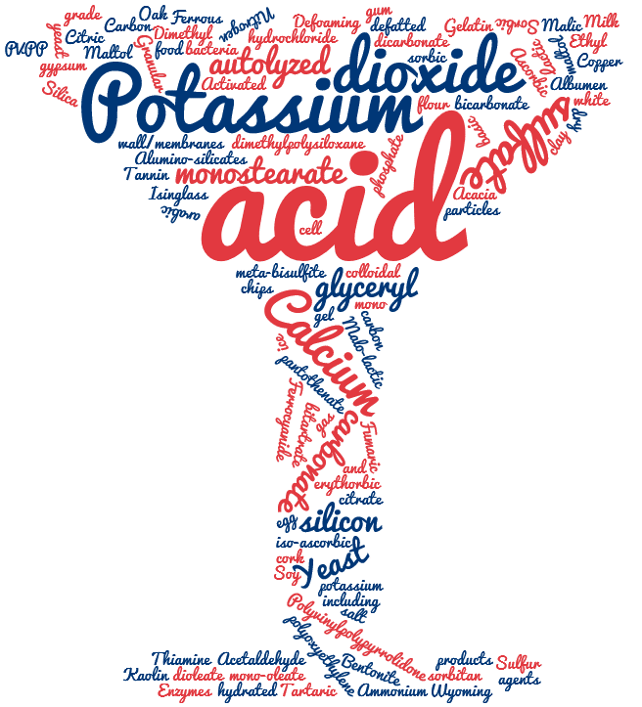
Certificates of Analysis
CAN BASIC TESTING SHOW “QUALITY”?
Additive Levels
Added in very small amounts
Added only when needed, often to increase “Quality”
Taste profile improvement
Removal of undesirable aromas
Maintaining microbiological stability
Mostly grape-derived, so difficult to determine added amount
Neither Presence nor absence would indicate lack of “quality” in a wine
Notes:
This is the PowerPoint presentation template for the International Wine Technical Summit.

Slide 28
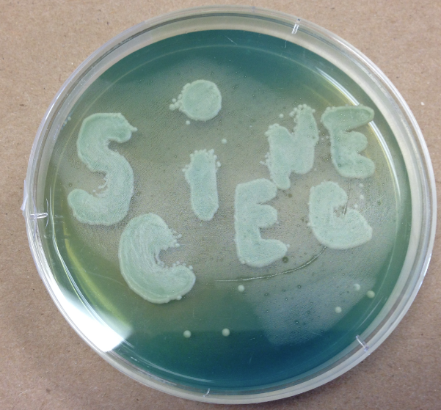
Certificates of Analysis
CAN BASIC TESTING SHOW “QUALITY”?
Microbiological
Yeast/fungus, Bacteria
If wine is unfiltered, their presence would not be surprising
Unfiltered wine is seen by some consumers as being of higher quality
Brettanomyces (yeast) influence is seen as positive by some, negative by others
Pathogens (E. Coli, Salmonella)
Result will always be “None Detected”
“Microbiologically, Wine is a Low Food Safety Risk Consumer Product”
(https://www.bio-conferences.org/articles/bioconf/pdf/2016/02/bioconf-oiv2016_04003.pdf)
Presence would not indicate lack of “Quality”
Notes:
This is the PowerPoint presentation template for the International Wine Technical Summit.

Slide 29
Certificates of Analysis
CAN BASIC TESTING SHOW “QUALITY”?
Physical Characteristics
Color, limpidity (clarity), Stability
Related to consumer preferences, age of the wine, or winemaking style
Very subjective, and may not allow for consumer preference
Are often based on traditional styles for the area of origin for the wine
“Quality“ based on physical characteristics can deny the customer the right to choose and may impair the production of traditional wines.
Notes:
This is the PowerPoint presentation template for the International Wine Technical Summit.

Slide 30
Certificates of Analysis
CAN BASIC TESTING SHOW “QUALITY”?
Typical Wine Parameters
pH, Acidity, sugars, density, etc.
Mostly grape-driven, so a narrow range of values, but levels vary due to differences in grape growing or necessary adjustments in winemaking
Wines from the same region, grower, or vineyard can vary widely
Consumers often dictate a style that affects these parameters
Grapes exert a huge influence on these values
Variation is too large to use as a measure of “Quality”
Notes:
This is the PowerPoint presentation template for the International Wine Technical Summit.

Slide 31
Certificates of Analysis
CAN BASIC TESTING SHOW “QUALITY”?
Overall Rationale
“Quality” is very difficult to define, and may actually defy definition
“Quality” is often in the mind of the consumer
Analytical values by themselves cannot give an indication of quality, and due to regional, climatological, or stylistic differences, the limits would either be too restrictive, or so wide as to be meaningless
CERTIFICATES OF ANALYSIS DON’T ENSURE “QUALITY”
So… are they necessary?
Notes:
This is the PowerPoint presentation template for the International Wine Technical Summit.

Slide 32
Certificates of Analysis
SUMMARY
Certificates of analysis don’t ensure safety
Certificates of analysis don’t ensure Authenticity
Certificates of analysis don’t ensure “Quality”
In the APEC region, “…the costs of unnecessary testing and certification in the region (were) estimated at 1 billion USD per annum.”
$1,000,000,000 USD
$?,???,???,??? USD
Can we justify this expense?
Notes:
This is the PowerPoint presentation template for the International Wine Technical Summit.

Slide 33
Certificates of Analysis
IWTS Compendium of requested tests for COAs
IWTS Certificates of Analysis Compendium 5-31-2019
 |  |  | Country
Test | A | B | C | D | E | F | G | H | I
Alcohol |  |  |  |  |  |  | 
Citric Acid |  |  |  | 
Colors |  |  | 
Copper |  |  |  |  |  | 
Density |  |  |  |  | 
Free SO₂ |  |  |  |  | 
Hybrids |  |  | 
Iron |  |  |  |  |  | 
Lead |  |  |  |  |  | 
Methanol |  |  |  |  |  | 
pH | 
Residual Sugars (glucose+fructose) |  |  |  |  | 
Sorbic Acid |  |  |  |  |  | 
Sucrose |  |  |  | 
Total Extract |  |  |  |  | 
Total SO₂ |  |  |  |  |  |  | 
Volatile Acidity |  |  |  |  |  |  | 
Safety?
Authenticity ?
“Quality” ?
Additional Analytes Tested For by IWTS Countries
Aldehyde (Acetaldehyde)
Arsenic
Cadmium
Chloride
Ester (Ethyl Acetate)
Ethyl Carbamate
Fixed Acidity
Fusel oil
Pesticides
Potassium Ferrocyanide
Sodium Benzoate
Sulfate content
Total Alcoholic Strength
Total Acidity
Turbidity
Zinc
Data collected from IWTS Country participants as of 5/31/2019
Notes:
This is the PowerPoint presentation template for the International Wine Technical Summit.

Slide 34
Certificates of Analysis
Questions?
Thank you.

Slide 35
Certificates of Analysis
Group Discussion:
What is the primary purpose for the Certificate of Analysis testing (if any) that your economy requires?
What is the process for revising Certificates of Analysis requirements in your economy?
How many export Certificates of Analysis do you review each year, and what are the costs, such as staff time, associated to your economy?
Notes:
This is the PowerPoint presentation template for the International Wine Technical Summit.

