Slide 1
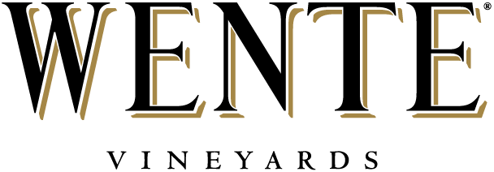
Good Manufacturing Practices and Analysis in our Winemaking Process

Slide 2
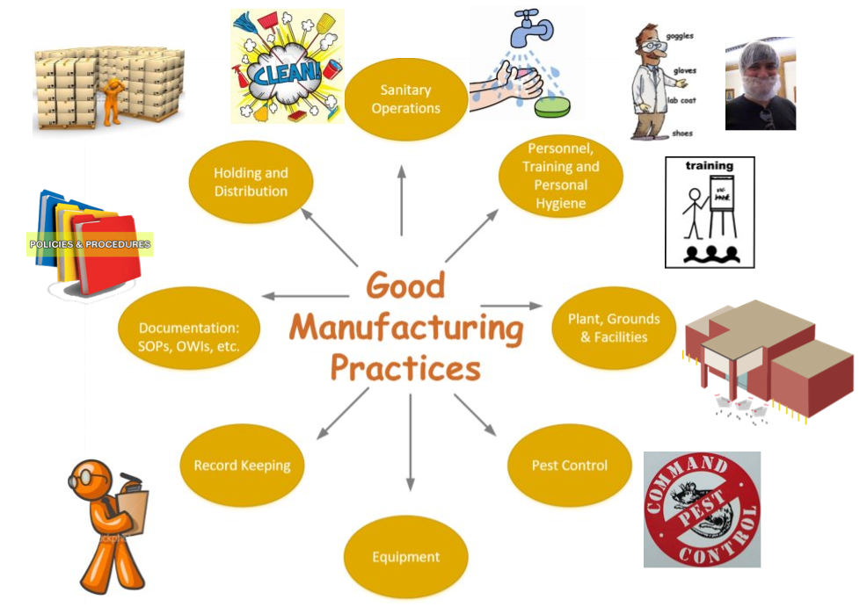
Good Manufacturing Practices
Notes:
At Wente Family Estates we incorporate Good Manufacturing Practices into our conversations with employees from day 1. All new employees are trained through our online portal, “Wente University”. This tool is integrated with our Human Resources software, so we can track when employees completed their training, and when a refresher course should be completed. Our Good Manufacturing Practices training covers all topics imperative to food and product safety. It’s also interactive, so people can really think about how Good Manufacturing Processes are used throughout our winery.

Slide 3
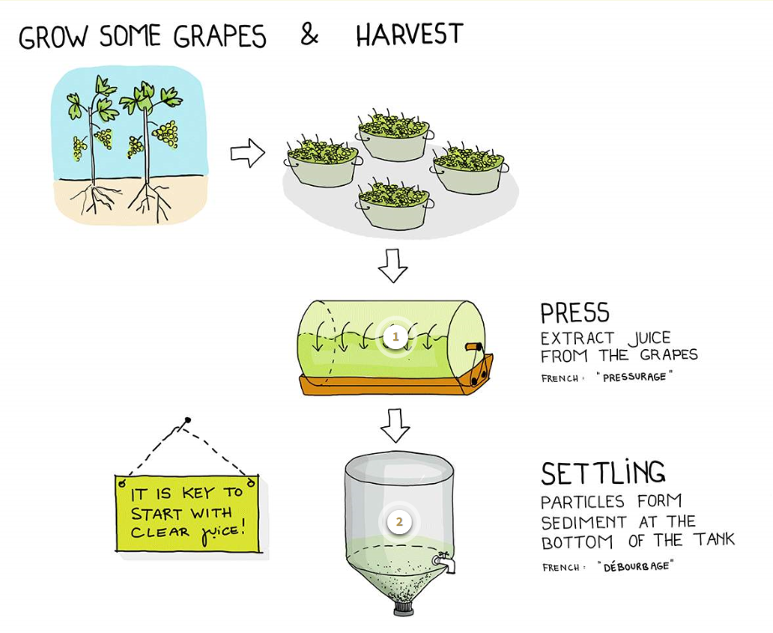
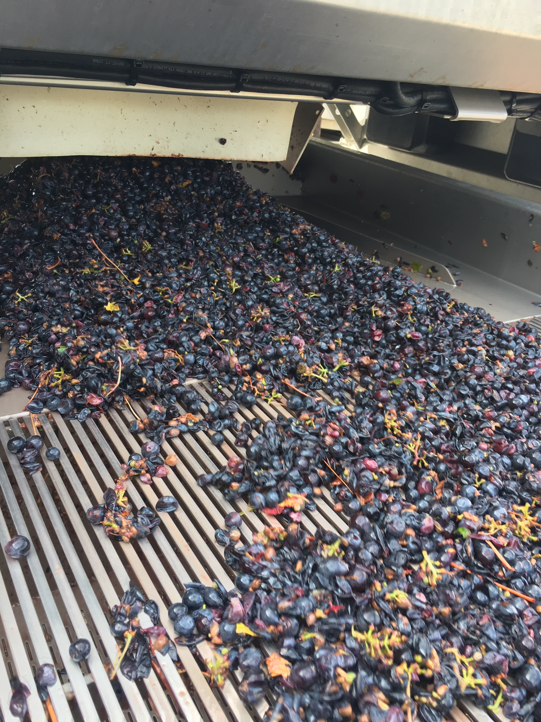
Brix, pH, TA,
“MOG” – Material Other than Grape
pH, TA, Brix
Brix, pH, TA, K, Malic, AMM, PAN
Notes:
Now I will talk about how grapes flow through our facility and what we measure at each step along the way.
When grapes are out in the field, we take samples for Brix, pH, and TA. This gives us a measure of ripeness, and we use these numbers to help determine what we want to pick next. Once the grapes are harvested and come across our scale into the winery, we perform a MOG inspection. MOG is material other than grape. We are looking for things like: large pieces of vines or metal clips that hold the wires out in the vineyard. We can manually remove these things from our grapes as they go across sorting tables, or we can use mechanical sorting systems. At Wente we use high strength magnets to pull out metal clips, our destemmer can kick out pieces of wood or other large objects, and this last year we started using an optical sorter that can even kick out individual berries based on size or color requirements. These systems ensure that nothing except grapes and grape juice can enter the tank/press.
There is no risk to human health, but sometimes mold can naturally occur out in the vineyard due to humidity in the canopy. When we see high levels of mold we do a proactive dose of Sulfur to help combat any oxidative or microbial activity that may naturally be occurring. This simply protects the juice from any harm to quality. The fermentation process will kill any mold or other microbes that come in from the vineyard.
Any additive from harvest up to bottle is attached with a unique lot number and follows the life of the wine all the way to bottle. This allows us to trace and track the use of any particular additive or to track any additives used in a particular wine.
Particles that sediment out are usually pulp from the grapes. Yeast like a certain turbidity or amount of pulp in juice, so this step is to ensure the happiness of the yeast through the fermentation. When yeasts are stressed or unhappy they can cause off flavors, and impact the sensory perception of the wine.
At this step in the process we run a juice panel. Here, we are measuring pH, TA, Brix, Malic, Ammonia, Primary Ammino Nitrogen, and Potassium. We measure Brix to again get an idea of sugar in the juice, and begin to target our final alcohol. pH, TA, Potassium, and malic are all measured to understand acidity in our juice and ultimately the wine. We can decide to alter acidity levels in our must or juice by adding tartaric acid at this point in time. AMM and PAN are measured because yeast also require a level of yeast assimible nitrogen to maintain a happy fermentation. If not enough YAN is present in our juice we can add a little more nutrition for the yeast, so they can carry out fermentation.

Slide 4
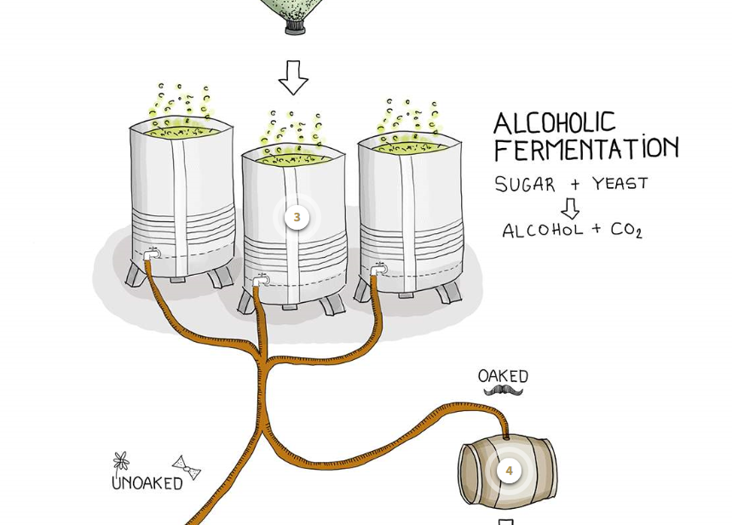
Temperature, Brix
GLU-FRU
Racking
GLU-FRU, Alc, pH, TA, AA, ML, SO2
Notes:
We begin alcoholic fermentation by inoculating with commercial yeast. Saccharomyces Cerevisiae is the main species we use; it has been selected for it’s high tolerance to alcohol.
Fermentation serves as our kill step in the winery. If the already low pH was not enough to completely kill most microbes the combination of this pH with alcohol will definitely do the trick. The only microbes that will be able to live in wine can cause quality issues as far as off flavors or odors, but pose no safety risk to the consumer.
So what do we measure during fermentation? We mainly measure temperature and brix. We monitor these closely, as well as smell our fermentations daily to ensure yeast is maintaining a good ferment, and no fermentations seem stressed or pose a risk for stuck fermentation. When brix gets to zero, we begin monitoring Glucose + Fructose levels, until we achieve dryness.
After alcoholic fermentation red wine is pressed, red and whites are then racked off of gross lees. Gross lees are the majority of the yeast used in fermentation that has settled down to the bottom of the tank, as activity and CO2 production has stopped.
We then do our first wine panel. We measure GLU FRU levels, alcohol, pH, Titratable acidity, Acetic Acid, Malic acid. If wines are not going towards ML fermentation, we will do our initial dose of sulfur, and measure sulfur levels. This will help protect from oxidation as well as ensuring the wine does not begin to go through ML fermentation. We can again adjust our acid levels, if desired for taste or texture on the palate.

Slide 5
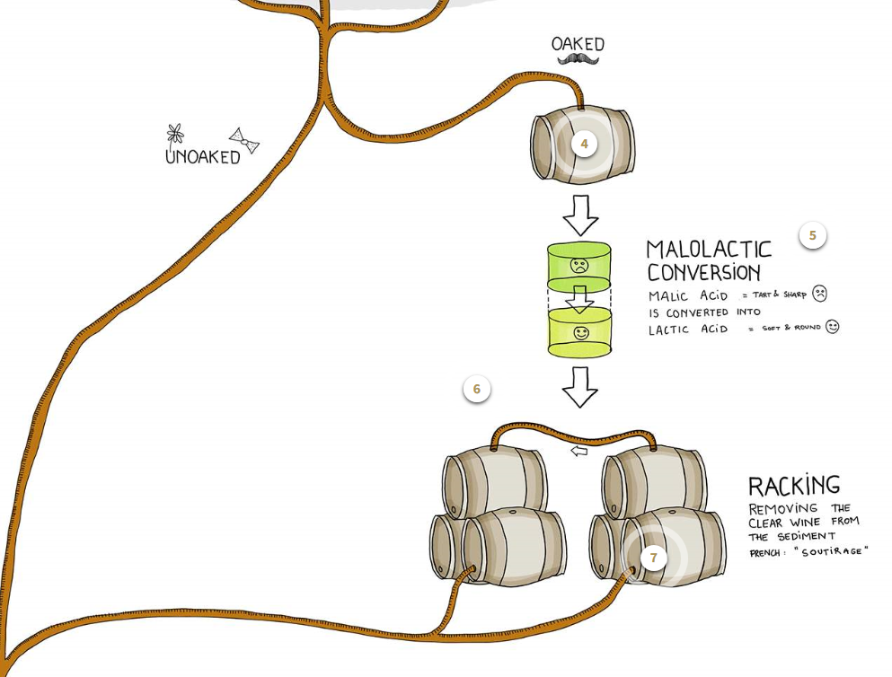
ML, AA, pH, TA
Notes:
We inoculate wines that we wish to go through ML fermentation with Oenococcus bacteria. This has the ability to live in wine and converts malic acid to lactic acid. Throughout this process, we monitor Malic levels, pH, TA (as they change with the conversion of acids), and acetic acid. We measure acetic acid during this time, as it can be produced from Oenococcus Oeni metabolizing any residual sugars that may remain. Other bacteria commonly known to live in wine such as acetic acid bacteria, or lactic acid bacteria can produce acetic acid as well. If we see our Acetic acid levels climbing, it may signify that one of these types of bacteria may be present in our wine. If so, we can decide to call off ML fermentation and proceed with sulfuring or filtering our wine. These bacteria are not harmful to consumers, but because high levels of acetic acid can make the wine taste like vinegar they are often not desirable.
Racking – The remainder of the yeast/ any solids still remaining after the first racking
From here, all wines are sulfured and prepared for aging in either stainless steel vessels or barrels.

Slide 6
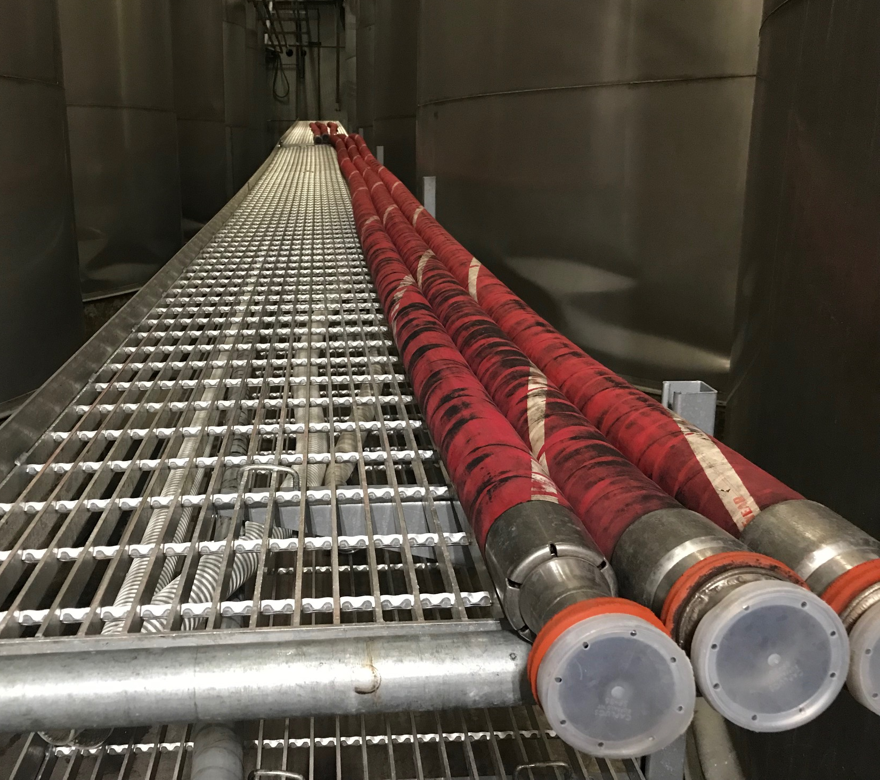
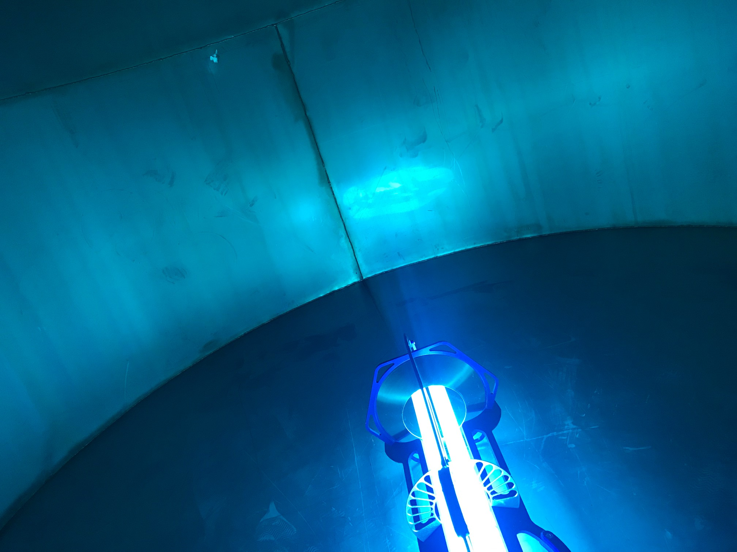
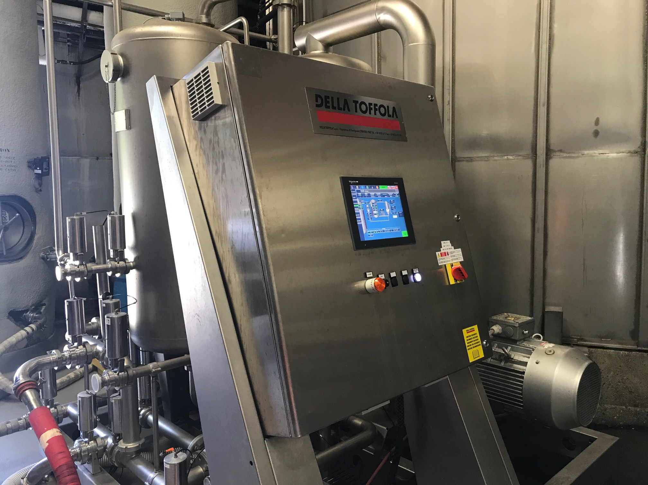
Notes:
Throughout this process, and during the aging process we use the following processes and procedures to ensure the quality of our product.
We keep all of our hoses stored on racks. These racks are off the ground, and have a slope. The ends are capped so no pests can enter, but have small holes, so water left from sanitizing procedures can still drain.
We have tank clean in place (CIP) Procedures – depending on the soil load, we can use chemicals to clean (some of the chemicals we use are: Potassium hydroxide and non-chlorinated tri-sodium phosphate). After a tank is cleaned, we sanitize the tank with either paracetic acid, ozonated water, or a UV light. This final step ensures we kill any microbes that may have survived after the cleaning procedure. We verify sanitation, any time we clean, using an ATP swab. Those records are entered into the computer, and tracked.
One of the most important tools in our process is filtration. This is a crossflow filtration unit that we have at our winery. Filtration is useful to ensure a high-quality product. Our crossflow filters prohibit anything larger than 0.2 micron from passing through them. Filtration is especially important as we near bottling.

Slide 7
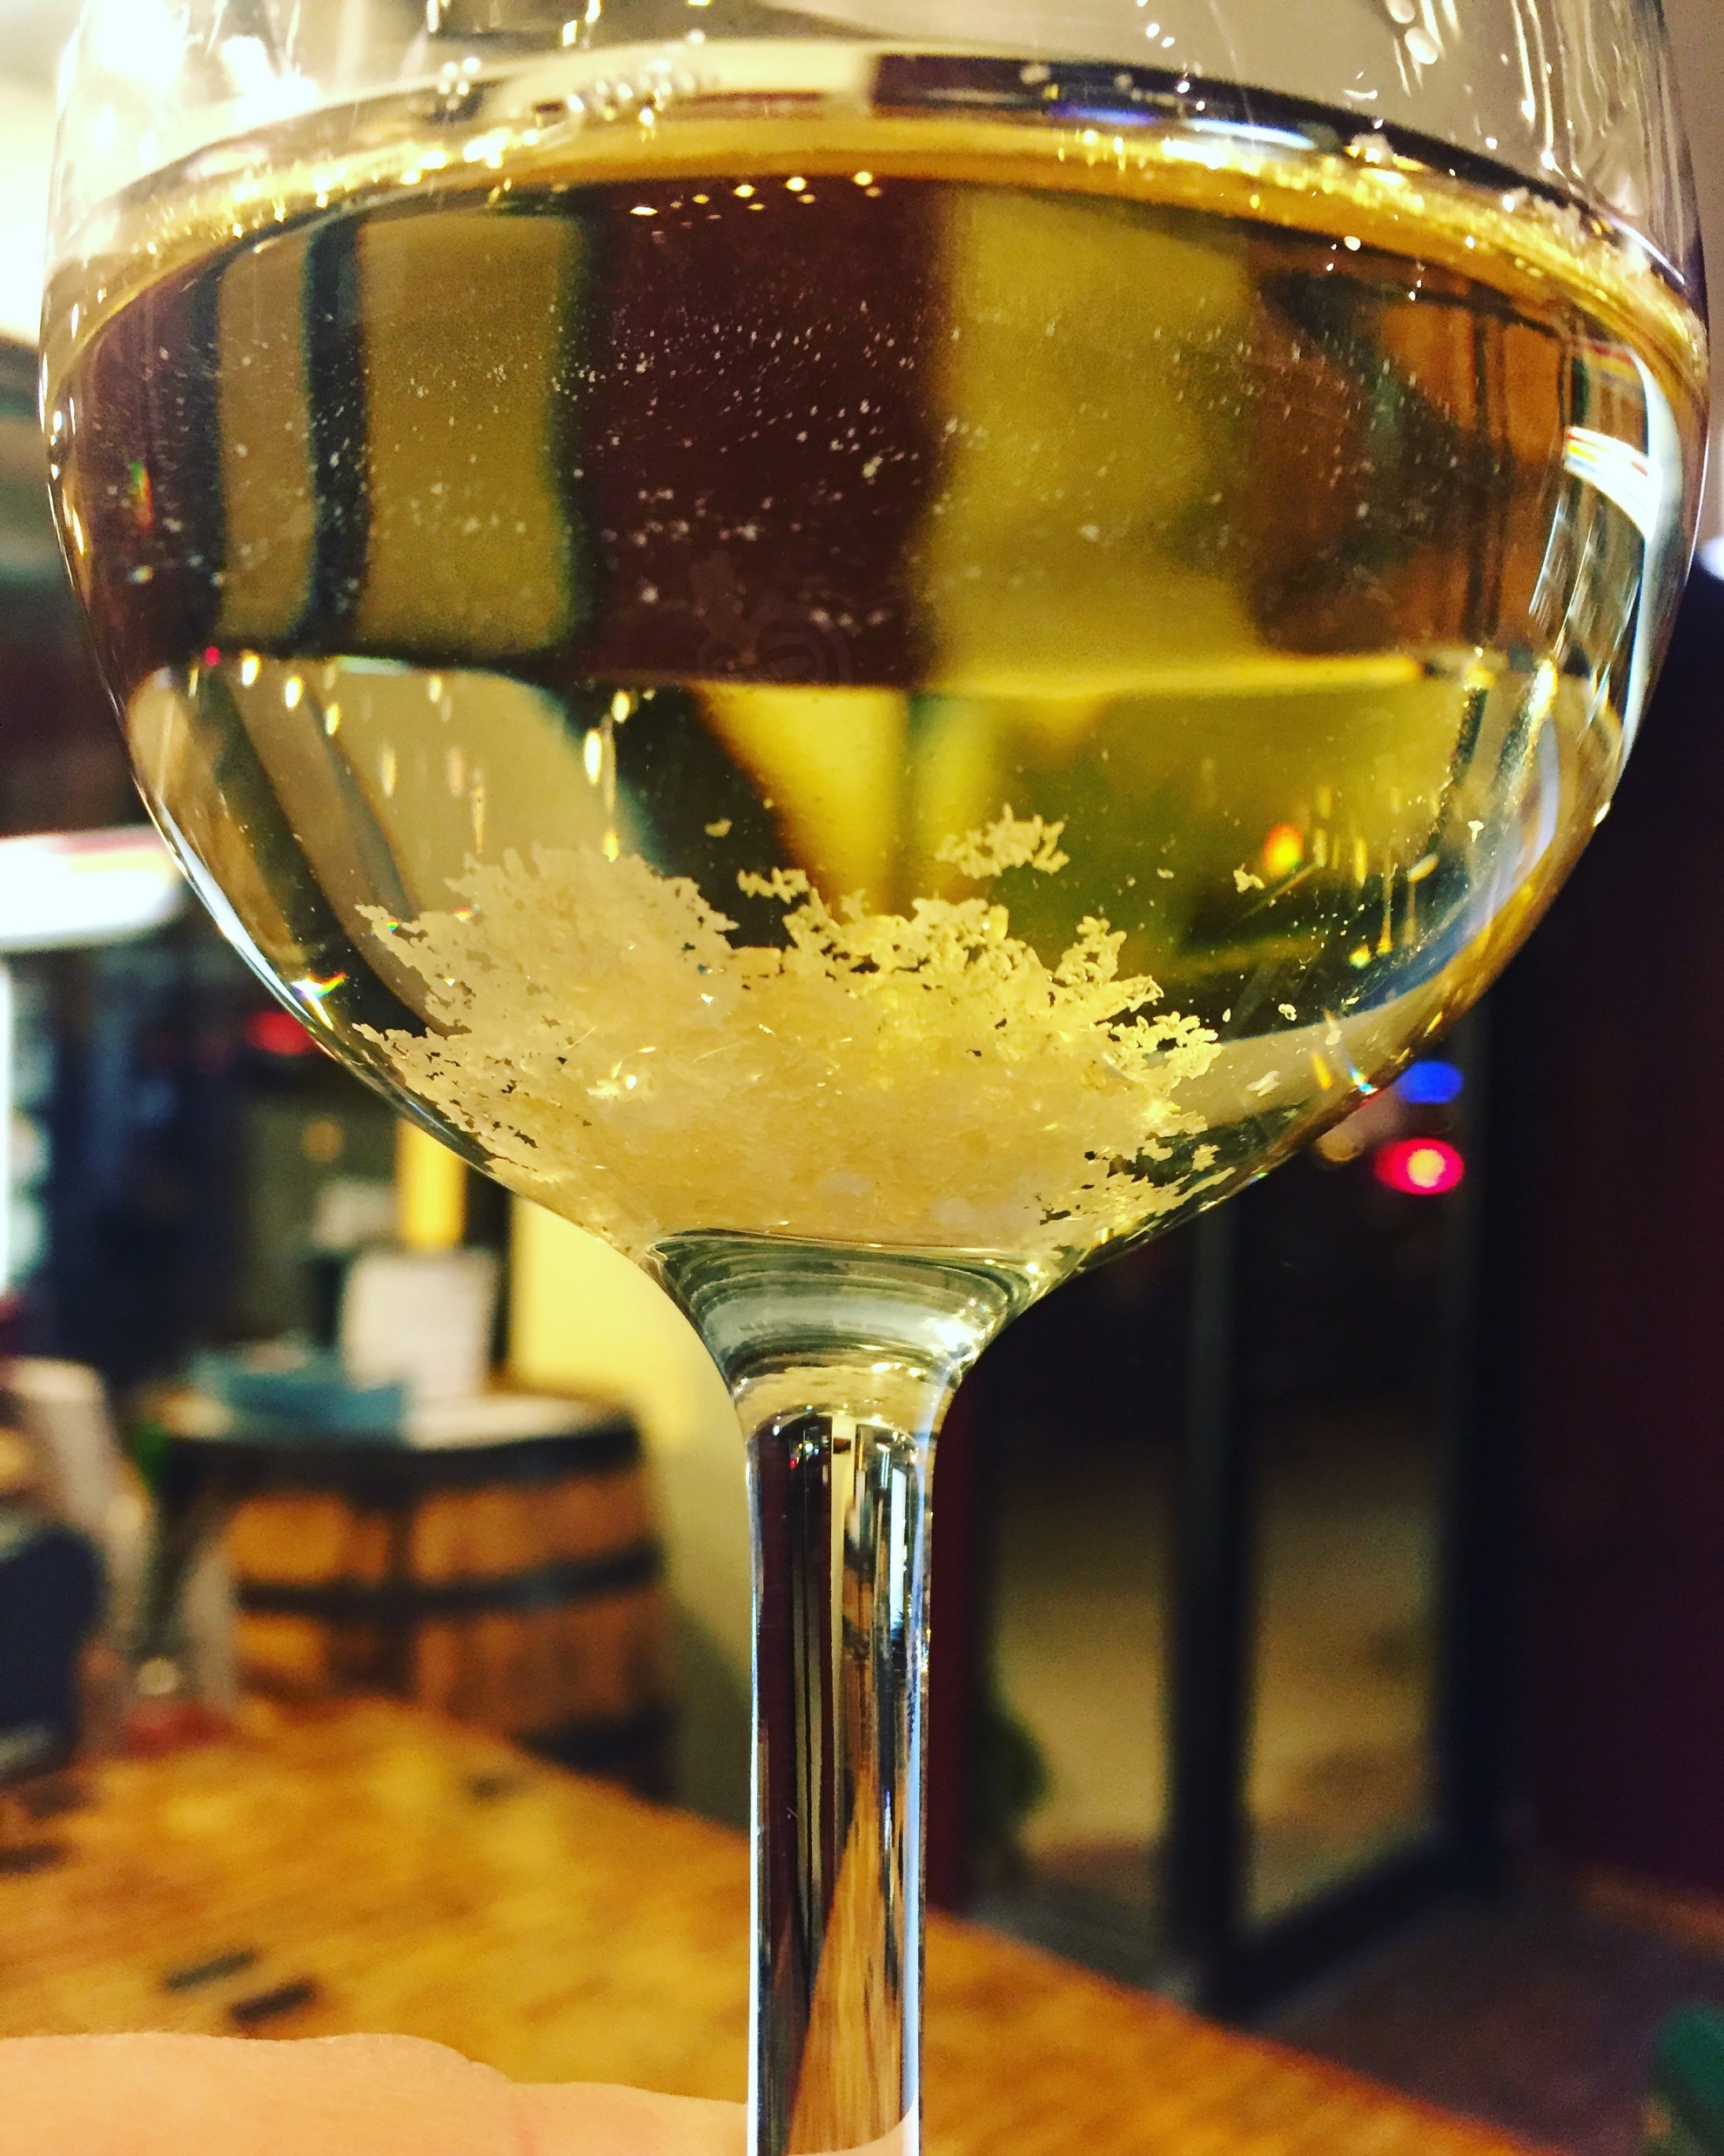
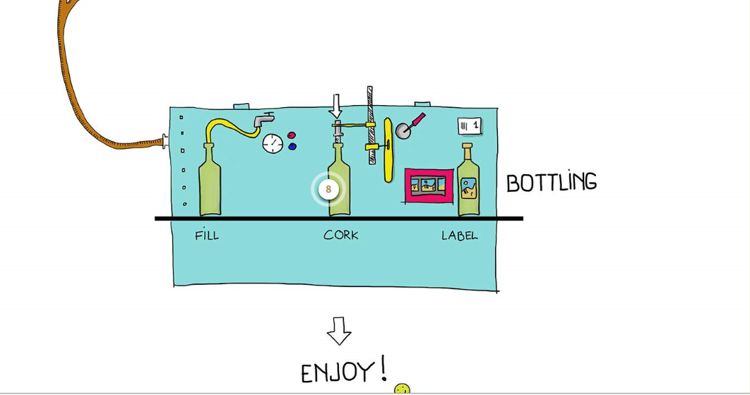
pH, TA, AA, SO2, ML, RS, Alc,
Cold Stability
DO, SO2
Plating
DO, SO2
Notes:
Run a full wine panel, so we have all analysis prior to bottle. One of the most important things is alcohol so we can be in compliance with alcohol labeling.
We also measure cold stability. When wine is cooled, potassium and tartaric acid can bind to form potassium bitartrate crystals. They are not harmful to ingest. These crystals often jokingly called “wine diamonds” can be seen as a fault as some people think the crystals look like glass, or believe that something is wrong with the wine. Pre-bottling, we can treat the wine, so that these crystals are no longer able to form, and thus the consumer will not perceive any quality issue.
Filtration – The pore size in our filtering protocol is smaller than any yeast or bacteria, so no microorganism can get through into our final product. At Wente all wines are filtered into the bottling staging tank by a 0.2 micron crossflow and filtered again at bottling through 0.5 and 0.45 micron sterile membrane filters.
SO2 – antioxidant and antimicrobial properties, and helps ensure a quality product on the shelf.
DO – want low DO so premature oxidation does not occur in bottle. This will simply make the wine taste old.
Post bottling, we filter a bottle of wine on the benchtop and using plating techniques to validate that no yeast or bacteria is present in our final product. All products are placed on a 10 day micro-hold pending a passing result.

Slide 8
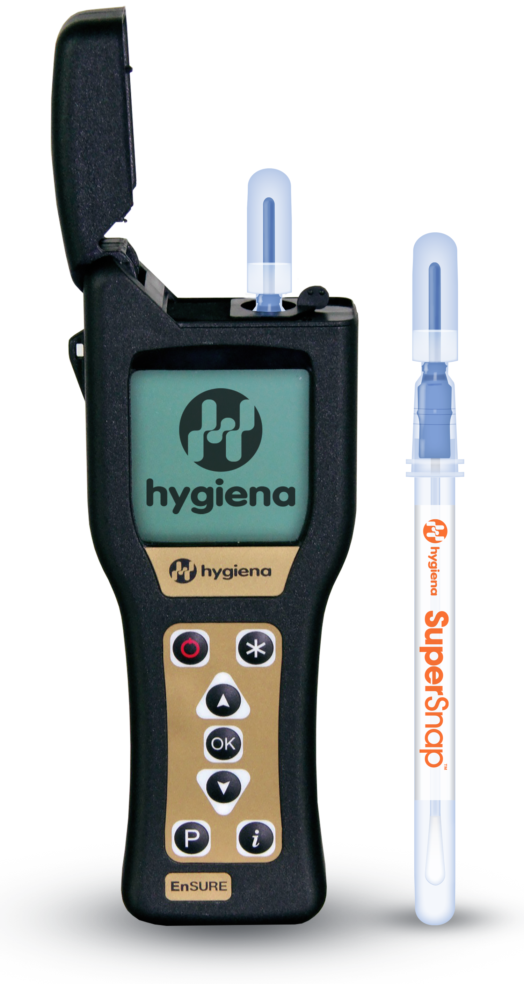
Notes:
I would like to go into a little bit more detail around our bottling procedures.
Our bottling line, much like our tanks, has a very specific clean in place procedure. It is tied to software that automatically tracks the time and temperature of our CIP, so we can validate that the water was up above the required temperature for long enough to kill any microbes. ATP swabbing – verifies CIP procedure
Our sterile membrane filters are checked daily by a bubble point test to ensure the integrity of the membrane.
All areas where a bottle is left open to the air are fully enclosed in a positive pressure air room. This means that the room constantly has air pushing out, so no microbes can be introduced through gaps or doors. The air being pushed into the room is filtered through HEPA filters. All personnel in filler rooms must comply with PPE requirements (gloves, hairnets, safety glasses, removal of jewelry).
We also have a breakage procedure, so that if any bottle breaks in the filler, all bottles must be removed and destroyed immediately. The filler must be cleaned of any debris before bottling can continue.

Slide 9
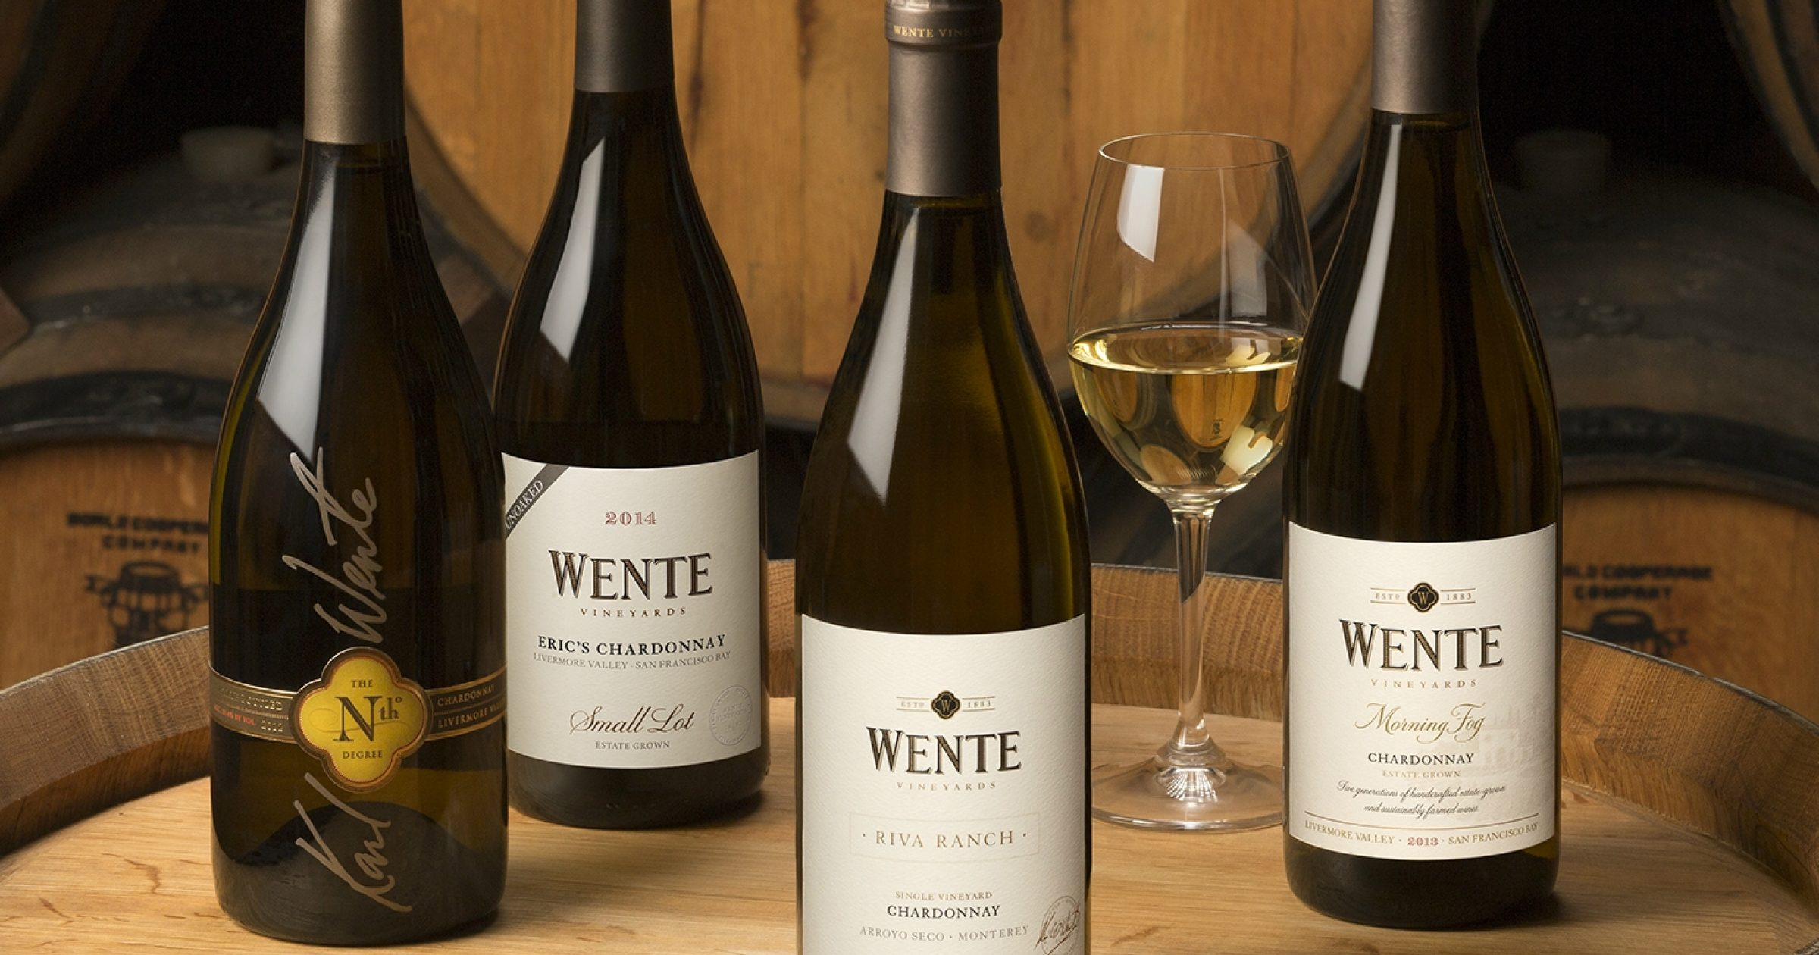
Thank You
Questions?
Alexandra.Ball@wentevineyards.com

